Slide 1

Feature engineering in machine learning
Presented By:-
Hrishikesh Deshpande
ads

Slide 2
What is feature engineering ?
It is important technique used in machine learning to create a model.
It used to convert many operations that are mainly performed on variables / features to fit them into algorithm.
It also helps to improve accuracy of our model then prediction also will be accurate.
The model with feature engineering is perform better than basic ml model. And mainly it organizes dataset perfectly.
Why feature engineering :
There is some issues in our datasets so, by applying feature engineering scale on variables/ features the model will predict well in future.

Slide 3
What is imputation technique in feature engineering ?
We will get some missing values in our dataset like in columns, value might get miss. So, handling those missing values, we use imputation technique.
Like datasets also might have missing values, it can cause problems for ml algorithms for predictions.
So, it will be good for handling missing values and replace / reform it for good prediction.

Slide 4
How we deal by using imputation for missing values ?
For handling missing values for both categorical and numerical datasets / labels, we use mean , median and mode here.
It works for both numerical as well as for categorical data.
In practical wise :
x = df[‘col.name’].mean()
df[‘col.name’].fillna(x, inplace=true)
Like this syntax, we use for median and mode also.
For checking missing values we can also use df.info() , df.isnull() , df.isnull.sum() according to this we will check for each column.

Slide 5
What is feature encoding ?
This is conversion of categorical features / columns into the numeric values or in labels as machine learning models cannot handle the tesxt data directly.
According to this our model will predict well and we use algorithms in our model and will develop it.

Slide 6
What are the different types of feature encoding in ml ?
There are 2 types in feature encoding :
1. Label Encoding
2. one hot encoding
1. label encoding : it converts the labels into numeric form to convert it into machine readable format because without this machine cannot read that data.
After this, machine will handle labels in well manner.
Basically, if your columns data is in category like male, female ,yes, no then we have to convert it into labelled format like 0 ,1 .
E.g. col name = fruits :
mango , apple , watermelon -----→ 0 , 1 , 2
so, these are labels for particular names.

Slide 7
2. One hot encoding :there is one advantage of label encoding ----- we apply label encoding for our labels but what if we have to apply that on features column, then it will assign values for data like 0, 1 but our model might consider it like priority basis like 0 – less, 1 – more but it’s not like that.
so, to overcome this prob we use one hot encoding technique to work on features.
It does operations on features.
If feature column has 4 values then it will splitting the categories into different columns, then it will put 0 for null value and 1 for appropriated column value.

Slide 8
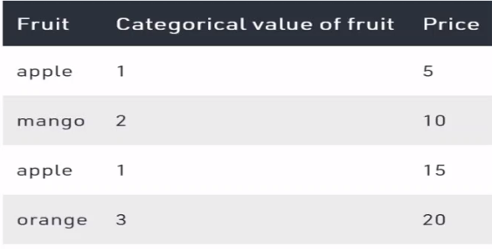
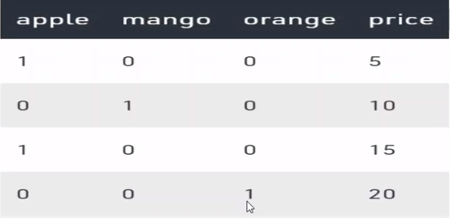
Example for one hot encoding :
After applying one hot encoding to the feature column
It will split the categories into diff. columns

